Slide 1


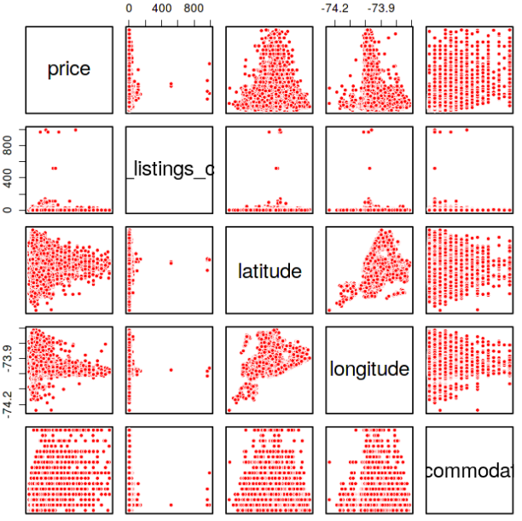
What I Did Right
What I Did Wrong
Examine Data: Data type, Number of levels, N/A
I pick too many variables with low training RMSE but high testing RMSE
Clean Data: Remove variables, manually deleted outliers and useless data
Do not consider categorial features clearly
Pick Variables: Use feature selection to pick useful variables, eg:correlation plot, backward selection method.
Model Selection
Find a right way to handle with missing values, median/mean/0
Models | RMSE
Linear Regression | 65.49
Random Forest XG Boost Model | 53.65 51.64
If I have to do it again,
Try other models, such as boosting and lasso

